Slide 1
Introduction to NoSQL databases
Rasika Samarakoon

Slide 2
Structure
What the heck is NoSQL ?
Basic Introduction
Refresh on Relational Databases
Emergence of NoSQL databases
Common features & Types of NoSQL databases
Applications/Advantages of NOSQL

Slide 3
What is NoSQL ?
New class of databases that don’t use relational methodology
NoSQL = Non-Relational
Hang on…
Don’t remember relational concepts.. Need a refresh !

Slide 4

Relational Databases
Store data in tables(rows and columns)
Has a rigid/fixed structure(schema)
Normalization(normal forms)
Primary keys and indexes
Foreign key(referential integrity)
Use SQL to query and manipulate.
Needs mapping to application entities(ORM)
Example

Slide 5
Relational contd.
Consistency by implementing ACID transactions.
Atomic
Consitent
Isolation
Durable
Involves locking.
So what’s wrong with Relational…
Why NoSQL ?

Slide 6
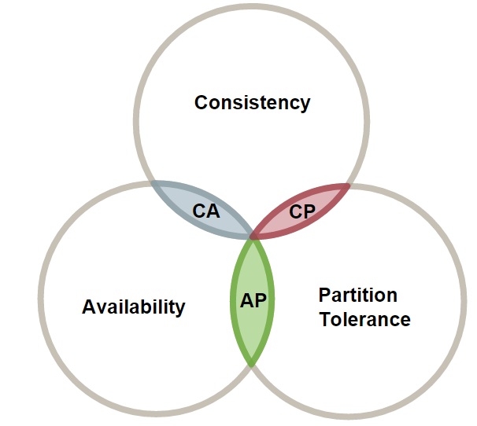
Need for NoSQL
Limitations/challenges of Relational Databases
Scalability(Sharding and distributed joins are hard)
Availability(Need to update multiple copies)
Highly available or scalable relational solutions are expensive.
Consistency can be relaxed.
CAP theorem
Alternative to ACID
Basic Availability
Soft-state
Eventual consistency

Slide 7
NoSQL Databases
Non relational databases with BASE properties.
Consistency is tuneable
Schemaless(Structure lives in the application)
Stored in different formats depending on the DBMS(JSON, C# objects, XML, plain text)
Higher performance/response time(Not all the cases)
Most of them are open source

Slide 8
NoSQL Databases…
Solve specific set of problems.
Come in different functionality.
Can be categorised into
Key/Value stores
Document databases
Column family databases
Graph databases

Slide 9



Key Value store
Basically a hash table
Values are large opaque BLOBS
Most of them support only insert, query, delete
Good for
Large volumes of unstructured data(videos, mp3 etc..)
Caching/Sessions
Example

Slide 10


Document databases
A set of named fields and values
Can be stored as JSON, XML, plain text etc..
Can query based on fields.
Some DBMS support secondary indexes.
Atomic transactions only at document level.
Example

Slide 11


Column Family
Group the data into families(based on access patterns)
Column families stored in separate files.
High performance
Fewer reads(avoid joins to read related data)
Columns are not static(store sparse data)
Atomic transactions on single column family
Example

Slide 12


Graph databases
Stores two type of information
Nodes(Entities)
Edges(Relationships) - can have direction.
Efficiently perform queries that traverse the network.
(Relational counterpart takes complex joins)
Supports ACID !
We are not Google, Amazon or Facebook…
So why should we care ?
Example

Slide 13
Applications/Advantages
High availability/scalability
Performance/higher throughput
Easy, Agile and flexible, no schema migrations
Capture data and structure asynchronously
Isomorphic applications(javascript/Node/MongoDB)
Storing
Cache/Session data(shopping cart)
User profiles/Logs/Product catalogs/communication
Graph structures(Path finding, connected data)
Polyglot solutions(micro services) Example

Slide 14
Next steps
Explore more
Learn modeling and designing(New way of thinking)
Evaluate possible use cases
Use it where applicable

Slide 15
Thank You !
Questions ???

